Slide 1

A Revolution for All Your Forms
Brought to you by
FeatureFusion
Notes:
6s

Slide 2
Problem Statement
I'm worried that someone might hack my computer
I don’t know how to use technology!
It's just a small business; there's no need to digitize.
The software is very expensive!
If it works, don’t touch it!
Handwritten records feel safer!
True Reason Behind!
Transition takes effort!
Kamaruddin, Norhaslinda, Raja Durratun Safiyah, and Abdul Wahab. "Small and medium enterprise business solutions using data visualization." Bulletin of Electrical Engineering and Informatics 9.6 (2020): 2562-2568.
Brought to you by
FeatureFusion
Notes:
CJ: Huh, why you still use paper invoice!
ZY: Ei Susah Lah, You think just tekan tekan saja ke? JC: Everyone’s talking about business digitalization and automation, it’s like a magic tool. But here’s the thing: people don’t truly understand the struggles that SMEs face every day.

Slide 3
Problem Statement
I don’t know how to use technology!
99.5%
I scare later people hack my computer
Small Business Owners:
Managing with Excel or Pen & Paper Forms
The software is very expensive!
Small business, why take so seriously.
If it works, don’t touch it!
Hand record feel safer!
Kamaruddin, Norhaslinda, Raja Durratun Safiyah, and Abdul Wahab. "Small and medium enterprise business solutions using data visualization." Bulletin of Electrical Engineering and Informatics 9.6 (2020): 2562-2568.
Brought to you by
FeatureFusion
Notes:
25s
From recent research, we found that almost majority of small business owners still manage their operations using Excel spreadsheets and pen and paper forms. Yes! In 2024.
So what’s the reason behind this? Well, transition takes effort. It’s not just about adopting new tools—it’s about overcoming the fear of change and the time it takes to adjust. And that’s where we come in: to show you that we can indeed tekan tekan and get things done faster, smarter and better.

Slide 4





solution
Retrieval-augmented Generation
Database
Accounting Software
Interact
Uncle John
Data Analysis
Past Invoices
Corporate Knowledge
https://www.kaggle.com/datasets/cankatsrc/invoices
Brought to you by
FeatureFusion
Notes:
45s Introducing ReForm. With ReForm, we are combining the power of data analysis with GenAI and Retrieval-Augmented Generation to deliver a solution truly understands your company. Let’s be real, AI is not new, we have things like ChatGPT and Gemini out there in the market, but there’s something they can’t do – they don’t know your company’s knowledge. But imagine what can be done when we empower the AI to pull company data such as past invoices, inventory databases, company accounting software and more. Today, we’re going to show you just that. Let’s dive right into the demo.

Slide 5

A Revolution for All Your Forms
https://reform-sme.web.app
Brought to you by
FeatureFusion
Notes:
DEMO:
Over here, we have the main interface of our AI platform. With reForm, we aim to make life easy for end user. So all interaction with our platform is mainly done through the chatbot. For example, over here, I can choose to upload a sample past invoice. With this invoice, the AI will create a template to use for my future invoices. That way, a lot of manual work can be saved. Next, let’s say I have a lot of past invoices in the form of an Excel sheet, I can upload this Excel sheet and the AI will take it as my company’s data, which it will then store into its pool of data knowledge. Once I have done this, it is like having someone that knows everything about my company right at my fingertips. So now, I can ask the AI anything about the company inventory and it will be able to answer me in seconds. For example, I can get to know how many red bottles I have sold here. This saves a lot of time and effort as employees no longer need to manually go through Excel sheets, nor do they need the knowledge to query a database. The AI will take care of everything for you.
JJ HERE X2
Next we shall look at what reform can helps user in daily business activity. Here we want an invoice of 600 large bottles to MCMC. Sho the AI will helps update the inventory and generating an invoice according to the format. Later, the user may want to know an report of current stock. Hence, the AI found there is still lack of data, it will prompt user for the exisiting stock record. Then the AI will record this into the database to help user for maintaining it, a kind of rag. Then the AI produce a report and highlight the conclusion.
Lastly, user may want to know the trend of business, which a detailed report can be obtained in a single line. The AI will combine with web knowledge to eliminate the outlier trend. In this case, it successfully detetcted uncle roger opened an restaurant and purchase many orange bottle which it is a rare event and should not reflect the user favor. After that, a report that without considering the outlier and a conclusion will be highlight.
CONCLUSION:
30s
In conclusion, data is the lifeblood of modern business, and AI is the force that brings it to life. With reForm, we’re not just digitalizing your business, we’re unlocking the full potential of AI, transforming your data into your most powerful asset.
So, don’t wait for change—be the change. Let reFORM revolutionize the way you work, and together, we’ll unlock the full potential of your business.

Slide 6
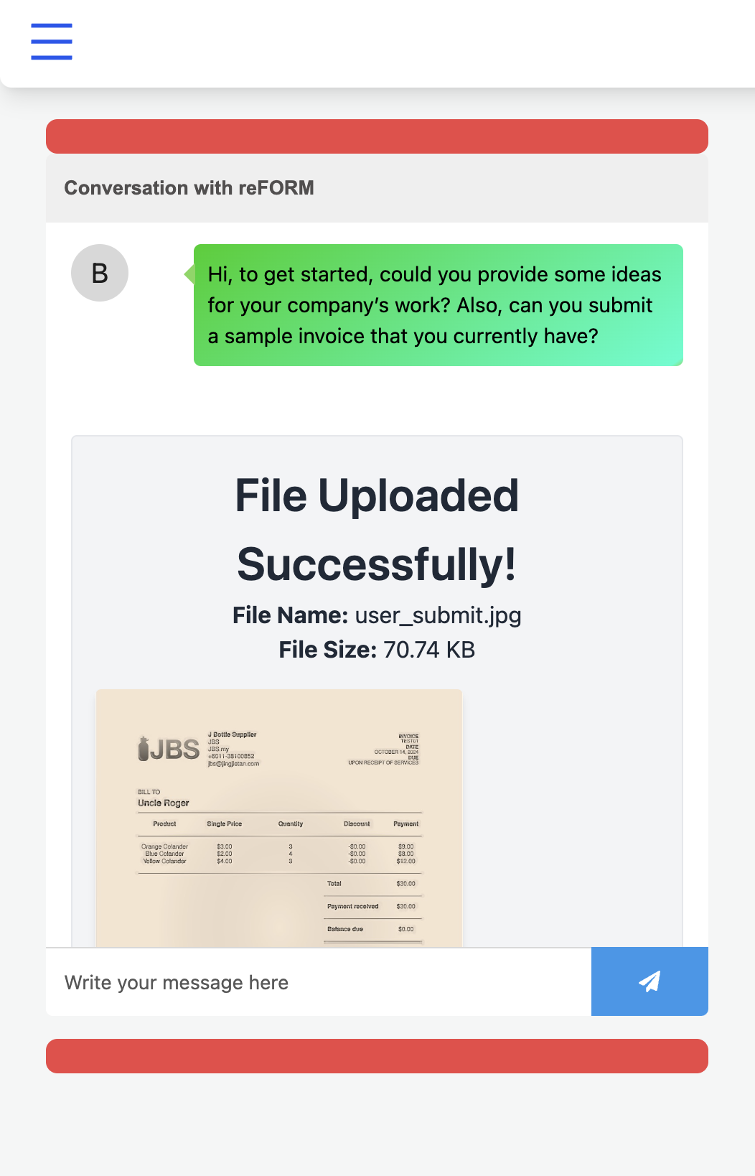
Get Started
Brought to you by
FeatureFusion
Notes:
DEMO:
Over here, we have the main interface of our AI platform. With reForm, we aim to make life easy for end user. So all interaction with our platform is mainly done through the chatbot. For example, over here, I can choose to upload a sample past invoice. With this invoice, the AI will create a template to use for my future invoices. That way, a lot of manual work can be saved. Next, let’s say I have a lot of past invoices in the form of an Excel sheet, I can upload this Excel sheet and the AI will take it as my company’s data, which it will then store into its pool of data knowledge. Once I have done this, it is like having someone that knows everything about my company right at my fingertips. So now, I can ask the AI anything about the company inventory and it will be able to answer me in seconds. For example, I can get to know how many red bottles I have sold here. This saves a lot of time and effort as employees no longer need to manually go through Excel sheets, nor do they need the knowledge to query a database. The AI will take care of everything for you.
JJ HERE X2
Next we shall look at what reform can helps user in daily business activity. Here we want an invoice of 600 large bottles to MCMC. Sho the AI will helps update the inventory and generating an invoice according to the format. Later, the user may want to know an report of current stock. Hence, the AI found there is still lack of data, it will prompt user for the exisiting stock record. Then the AI will record this into the database to help user for maintaining it, a kind of rag. Then the AI produce a report and highlight the conclusion.
Lastly, user may want to know the trend of business, which a detailed report can be obtained in a single line. The AI will combine with web knowledge to eliminate the outlier trend. In this case, it successfully detetcted uncle roger opened an restaurant and purchase many orange bottle which it is a rare event and should not reflect the user favor. After that, a report that without considering the outlier and a conclusion will be highlight.
CONCLUSION:
30s
In conclusion, data is the lifeblood of modern business, and AI is the force that brings it to life. With reForm, we’re not just digitalizing your business, we’re unlocking the full potential of AI, transforming your data into your most powerful asset.
So, don’t wait for change—be the change. Let reFORM revolutionize the way you work, and together, we’ll unlock the full potential of your business.

Slide 7
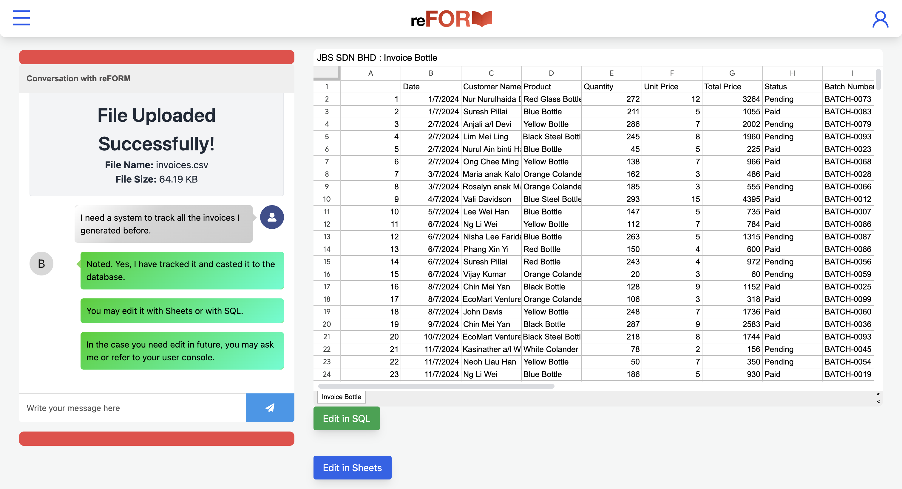
Brought to you by
FeatureFusion
Notes:
DEMO:
Over here, we have the main interface of our AI platform. With reForm, we aim to make life easy for end user. So all interaction with our platform is mainly done through the chatbot. For example, over here, I can choose to upload a sample past invoice. With this invoice, the AI will create a template to use for my future invoices. That way, a lot of manual work can be saved. Next, let’s say I have a lot of past invoices in the form of an Excel sheet, I can upload this Excel sheet and the AI will take it as my company’s data, which it will then store into its pool of data knowledge. Once I have done this, it is like having someone that knows everything about my company right at my fingertips. So now, I can ask the AI anything about the company inventory and it will be able to answer me in seconds. For example, I can get to know how many red bottles I have sold here. This saves a lot of time and effort as employees no longer need to manually go through Excel sheets, nor do they need the knowledge to query a database. The AI will take care of everything for you.
JJ HERE X2
Next we shall look at what reform can helps user in daily business activity. Here we want an invoice of 600 large bottles to MCMC. Sho the AI will helps update the inventory and generating an invoice according to the format. Later, the user may want to know an report of current stock. Hence, the AI found there is still lack of data, it will prompt user for the exisiting stock record. Then the AI will record this into the database to help user for maintaining it, a kind of rag. Then the AI produce a report and highlight the conclusion.
Lastly, user may want to know the trend of business, which a detailed report can be obtained in a single line. The AI will combine with web knowledge to eliminate the outlier trend. In this case, it successfully detetcted uncle roger opened an restaurant and purchase many orange bottle which it is a rare event and should not reflect the user favor. After that, a report that without considering the outlier and a conclusion will be highlight.
CONCLUSION:
30s
In conclusion, data is the lifeblood of modern business, and AI is the force that brings it to life. With reForm, we’re not just digitalizing your business, we’re unlocking the full potential of AI, transforming your data into your most powerful asset.
So, don’t wait for change—be the change. Let reFORM revolutionize the way you work, and together, we’ll unlock the full potential of your business.

Slide 8
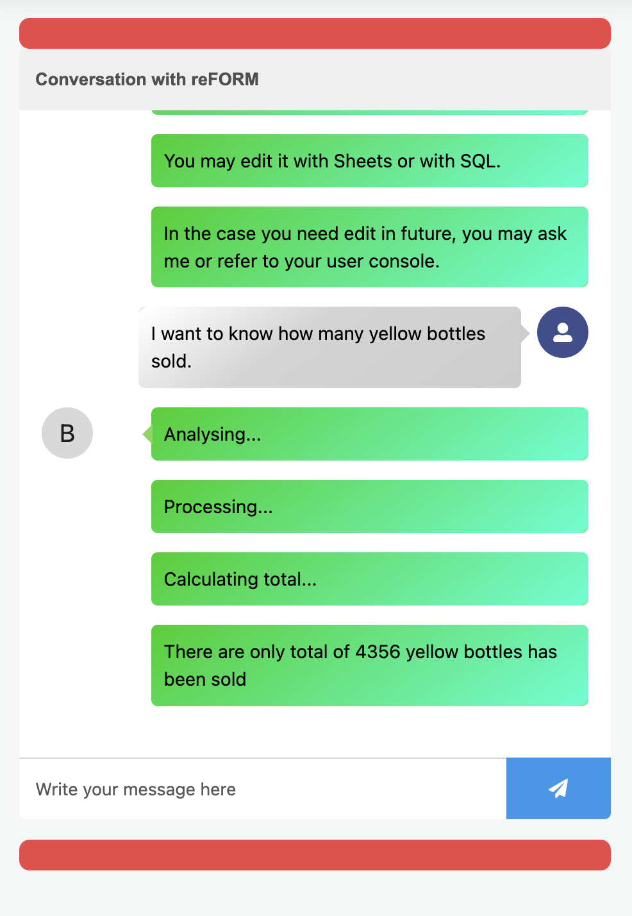
Answering
Brought to you by
FeatureFusion
Notes:
DEMO:
Over here, we have the main interface of our AI platform. With reForm, we aim to make life easy for end user. So all interaction with our platform is mainly done through the chatbot. For example, over here, I can choose to upload a sample past invoice. With this invoice, the AI will create a template to use for my future invoices. That way, a lot of manual work can be saved. Next, let’s say I have a lot of past invoices in the form of an Excel sheet, I can upload this Excel sheet and the AI will take it as my company’s data, which it will then store into its pool of data knowledge. Once I have done this, it is like having someone that knows everything about my company right at my fingertips. So now, I can ask the AI anything about the company inventory and it will be able to answer me in seconds. For example, I can get to know how many red bottles I have sold here. This saves a lot of time and effort as employees no longer need to manually go through Excel sheets, nor do they need the knowledge to query a database. The AI will take care of everything for you.
JJ HERE X2
Next we shall look at what reform can helps user in daily business activity. Here we want an invoice of 600 large bottles to MCMC. Sho the AI will helps update the inventory and generating an invoice according to the format. Later, the user may want to know an report of current stock. Hence, the AI found there is still lack of data, it will prompt user for the exisiting stock record. Then the AI will record this into the database to help user for maintaining it, a kind of rag. Then the AI produce a report and highlight the conclusion.
Lastly, user may want to know the trend of business, which a detailed report can be obtained in a single line. The AI will combine with web knowledge to eliminate the outlier trend. In this case, it successfully detetcted uncle roger opened an restaurant and purchase many orange bottle which it is a rare event and should not reflect the user favor. After that, a report that without considering the outlier and a conclusion will be highlight.
CONCLUSION:
30s
In conclusion, data is the lifeblood of modern business, and AI is the force that brings it to life. With reForm, we’re not just digitalizing your business, we’re unlocking the full potential of AI, transforming your data into your most powerful asset.
So, don’t wait for change—be the change. Let reFORM revolutionize the way you work, and together, we’ll unlock the full potential of your business.

Slide 9
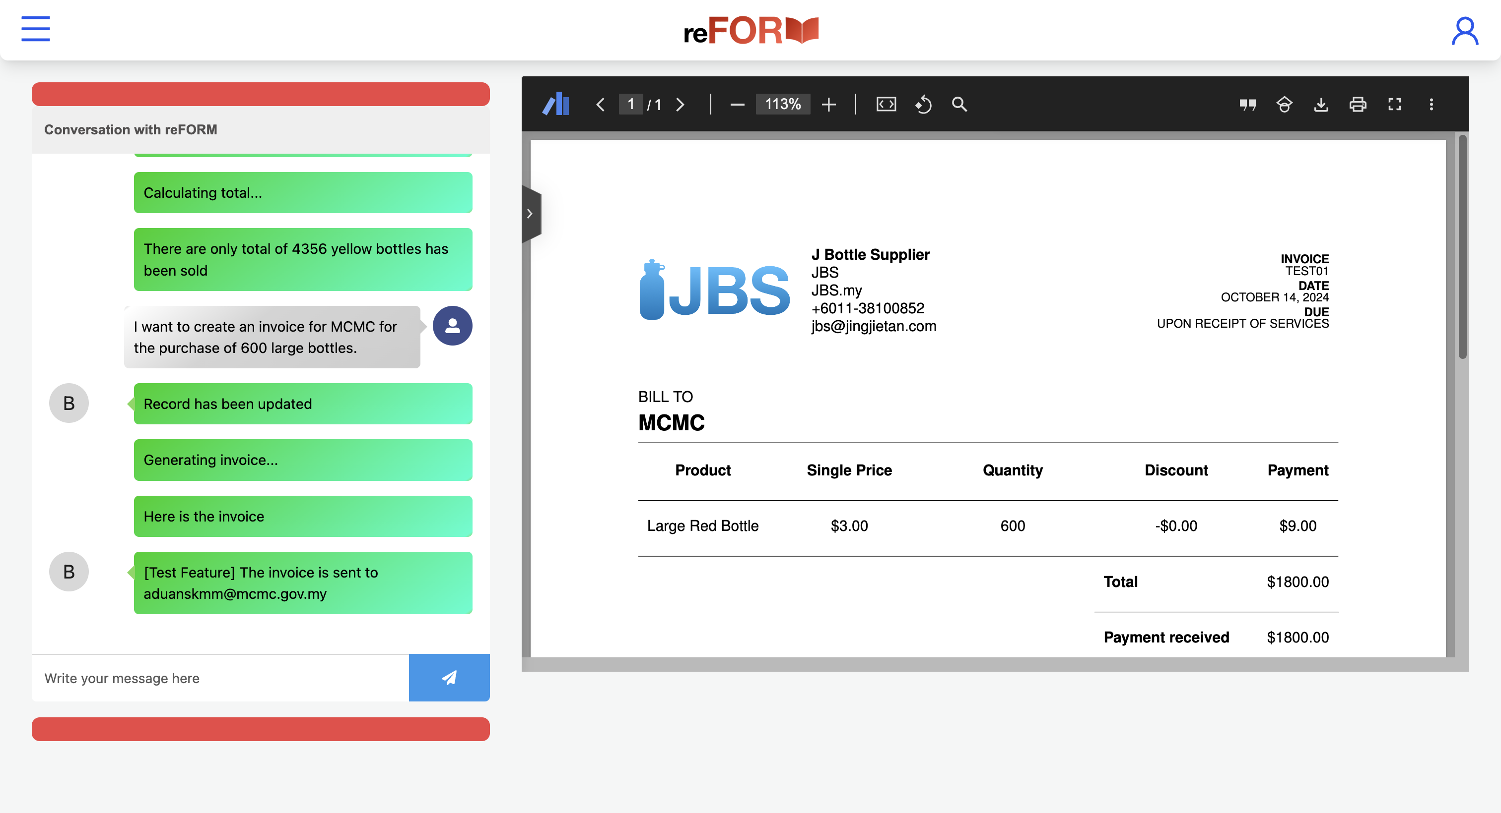
Brought to you by
FeatureFusion
Notes:
DEMO:
Over here, we have the main interface of our AI platform. With reForm, we aim to make life easy for end user. So all interaction with our platform is mainly done through the chatbot. For example, over here, I can choose to upload a sample past invoice. With this invoice, the AI will create a template to use for my future invoices. That way, a lot of manual work can be saved. Next, let’s say I have a lot of past invoices in the form of an Excel sheet, I can upload this Excel sheet and the AI will take it as my company’s data, which it will then store into its pool of data knowledge. Once I have done this, it is like having someone that knows everything about my company right at my fingertips. So now, I can ask the AI anything about the company inventory and it will be able to answer me in seconds. For example, I can get to know how many red bottles I have sold here. This saves a lot of time and effort as employees no longer need to manually go through Excel sheets, nor do they need the knowledge to query a database. The AI will take care of everything for you.
JJ HERE X2
Next we shall look at what reform can helps user in daily business activity. Here we want an invoice of 600 large bottles to MCMC. Sho the AI will helps update the inventory and generating an invoice according to the format. Later, the user may want to know an report of current stock. Hence, the AI found there is still lack of data, it will prompt user for the exisiting stock record. Then the AI will record this into the database to help user for maintaining it, a kind of rag. Then the AI produce a report and highlight the conclusion.
Lastly, user may want to know the trend of business, which a detailed report can be obtained in a single line. The AI will combine with web knowledge to eliminate the outlier trend. In this case, it successfully detetcted uncle roger opened an restaurant and purchase many orange bottle which it is a rare event and should not reflect the user favor. After that, a report that without considering the outlier and a conclusion will be highlight.
CONCLUSION:
30s
In conclusion, data is the lifeblood of modern business, and AI is the force that brings it to life. With reForm, we’re not just digitalizing your business, we’re unlocking the full potential of AI, transforming your data into your most powerful asset.
So, don’t wait for change—be the change. Let reFORM revolutionize the way you work, and together, we’ll unlock the full potential of your business.

Slide 10
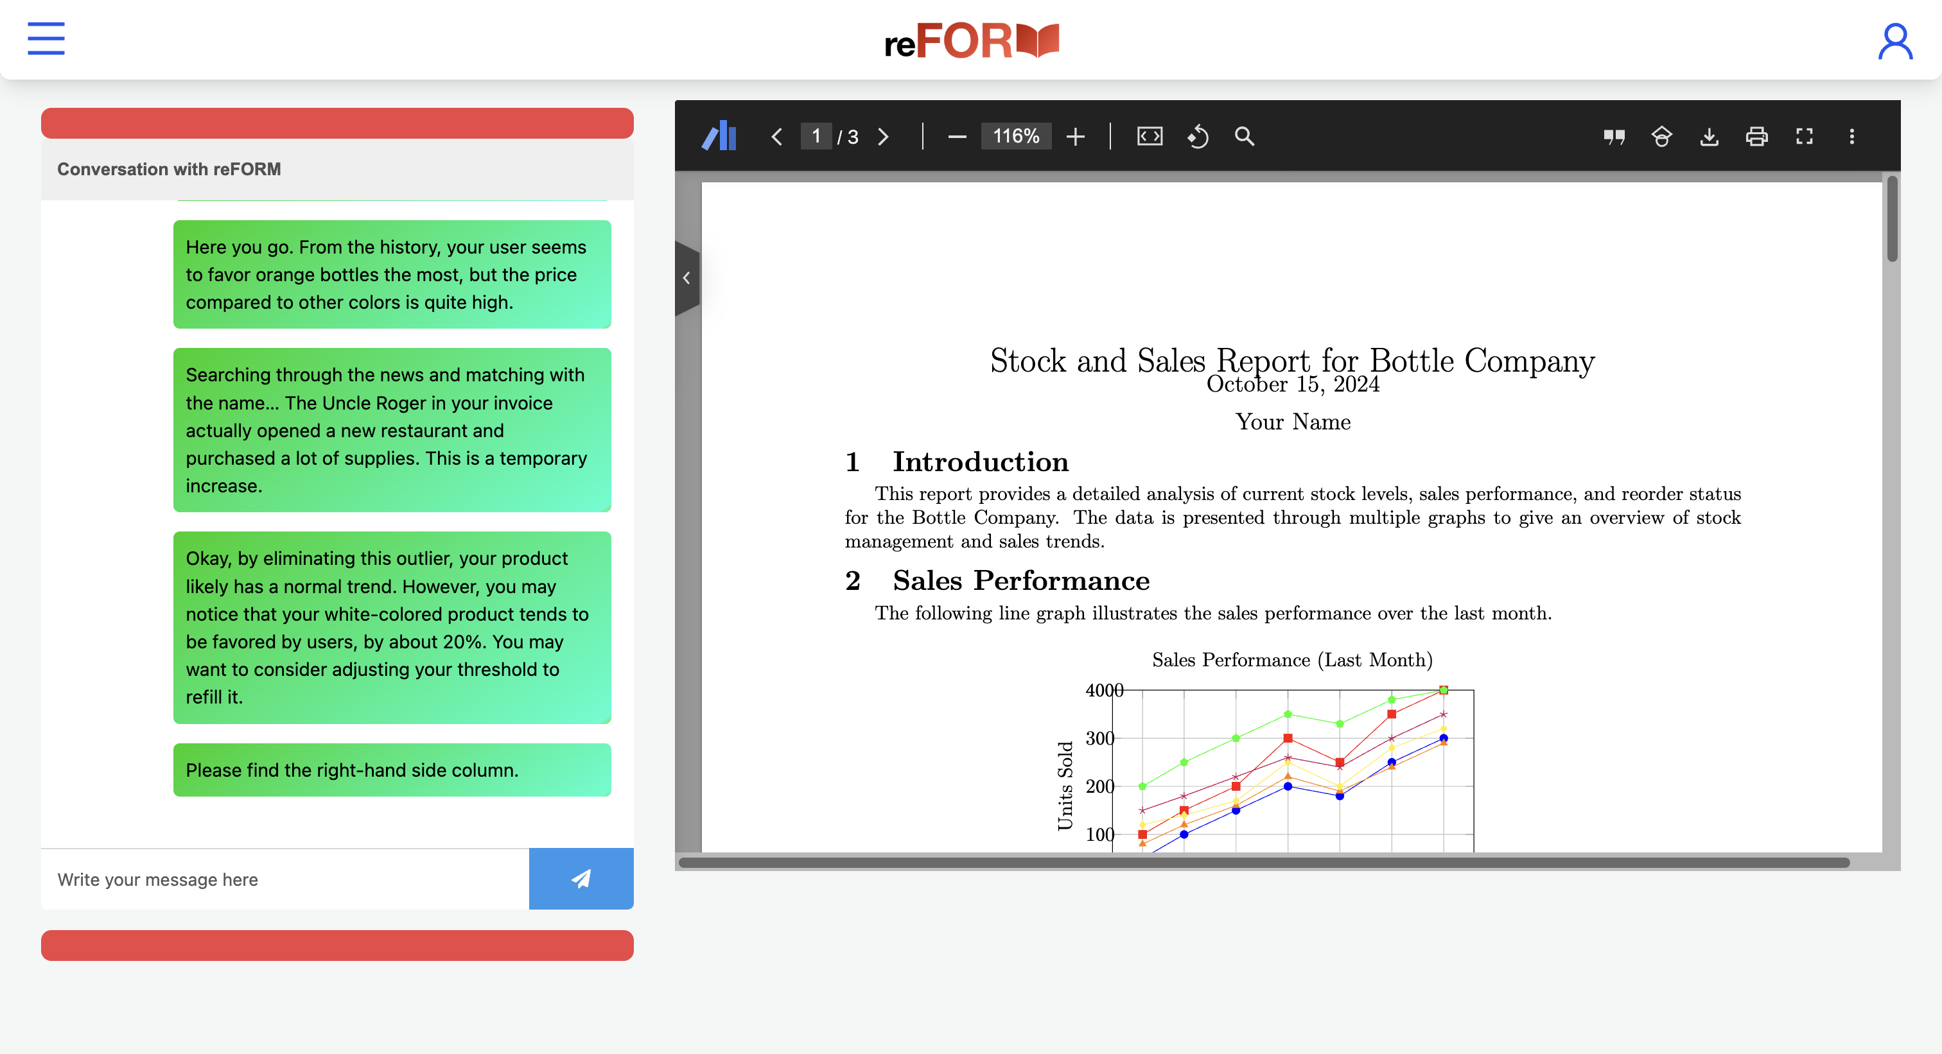
Brought to you by
FeatureFusion
Notes:
DEMO:
Over here, we have the main interface of our AI platform. With reForm, we aim to make life easy for end user. So all interaction with our platform is mainly done through the chatbot. For example, over here, I can choose to upload a sample past invoice. With this invoice, the AI will create a template to use for my future invoices. That way, a lot of manual work can be saved. Next, let’s say I have a lot of past invoices in the form of an Excel sheet, I can upload this Excel sheet and the AI will take it as my company’s data, which it will then store into its pool of data knowledge. Once I have done this, it is like having someone that knows everything about my company right at my fingertips. So now, I can ask the AI anything about the company inventory and it will be able to answer me in seconds. For example, I can get to know how many red bottles I have sold here. This saves a lot of time and effort as employees no longer need to manually go through Excel sheets, nor do they need the knowledge to query a database. The AI will take care of everything for you.
JJ HERE X2
Next we shall look at what reform can helps user in daily business activity. Here we want an invoice of 600 large bottles to MCMC. Sho the AI will helps update the inventory and generating an invoice according to the format. Later, the user may want to know an report of current stock. Hence, the AI found there is still lack of data, it will prompt user for the exisiting stock record. Then the AI will record this into the database to help user for maintaining it, a kind of rag. Then the AI produce a report and highlight the conclusion.
Lastly, user may want to know the trend of business, which a detailed report can be obtained in a single line. The AI will combine with web knowledge to eliminate the outlier trend. In this case, it successfully detetcted uncle roger opened an restaurant and purchase many orange bottle which it is a rare event and should not reflect the user favor. After that, a report that without considering the outlier and a conclusion will be highlight.
CONCLUSION:
30s
In conclusion, data is the lifeblood of modern business, and AI is the force that brings it to life. With reForm, we’re not just digitalizing your business, we’re unlocking the full potential of AI, transforming your data into your most powerful asset.
So, don’t wait for change—be the change. Let reFORM revolutionize the way you work, and together, we’ll unlock the full potential of your business.

